Slide 1



CubeSat Reaction Wheel Attitude Control Platform 10/3 Meeting

Slide 2
General Updates/Reminders
CubeSat paper is finally complete, ACTIV development will now commence
Student Research Symposium will be in mid-November
Lab hammock is open for business
Notes:
Duplicate slide and fill in relevant information

Slide 3
Current Project Goal
Achieve multi-motor functionality before applying system to CubeSat
Manufacture inverted pendulum to serve as beginner controls platform
Begin work on ACTIV (timeline TBD)
Notes:
Duplicate slide and fill in relevant information

Slide 4

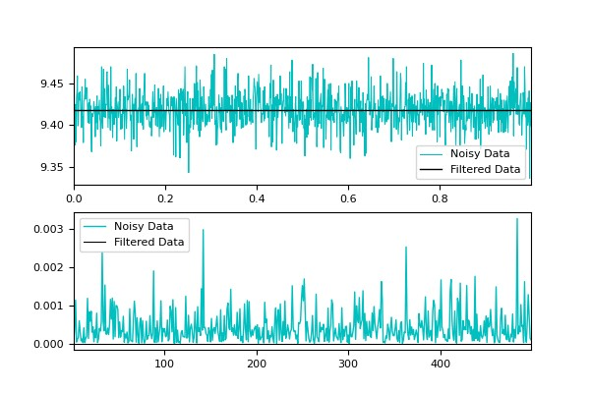
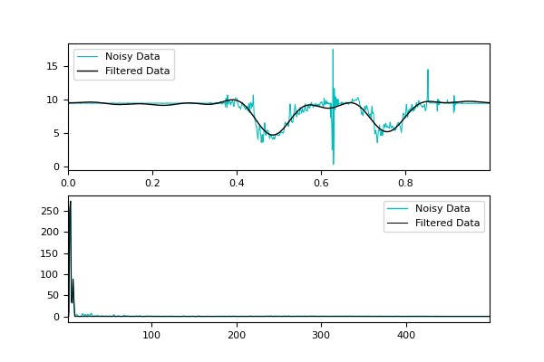
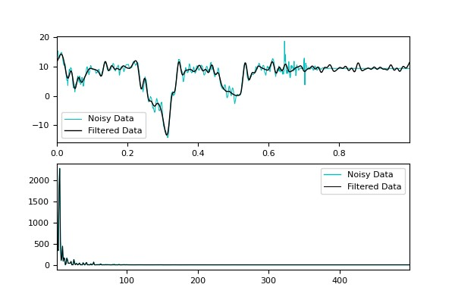
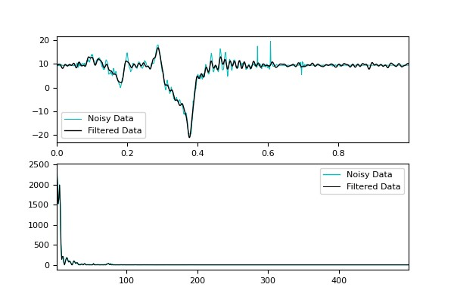
[Ryan] Attitude Estimation and Signal Processing
Progress completed this past week
Experimented with fast Fourier transform (FFT) to clean signal data from IMU
Signal cleaning seems to work
Need to attempt attitude determination in real time with cleaned data
Working on adding a QUEST branch to main PID Controller on the github
Goals for next week
Full implementation of attitude determinator without yaw drift to PID controller
Anticipated challenges
FFT might be too slow for .001 Hz signal, may need to adjust
Notes:
Duplicate slide and fill in relevant information

Slide 5
[Justin] Paper complete
Progress completed this past week
Paper complete [100%]
PID CubeSat application halted due to power concerns (did not have proper cables)
Goals for next week
Begin attempting multi-motor control with ODrive S1s
Make detailed development timeline for ACTIV
Submit abstract to SRS
Anticipated challenges
Daisy-chaining
Notes:
Duplicate slide and fill in relevant information

Slide 6
[Ella] Bottom Claw and Cube Config.
Progress completed this past week
-Print the new design and add it to the whole system
-Change threaded insert hole diameter
-Highlight based on: In Progress
Goals for next week
-Design new claw system for bottom cube configuration
Anticipated challenges
-Threaded insert holes clash with battery cut out
Notes:
Duplicate slide and fill in relevant information

Slide 7
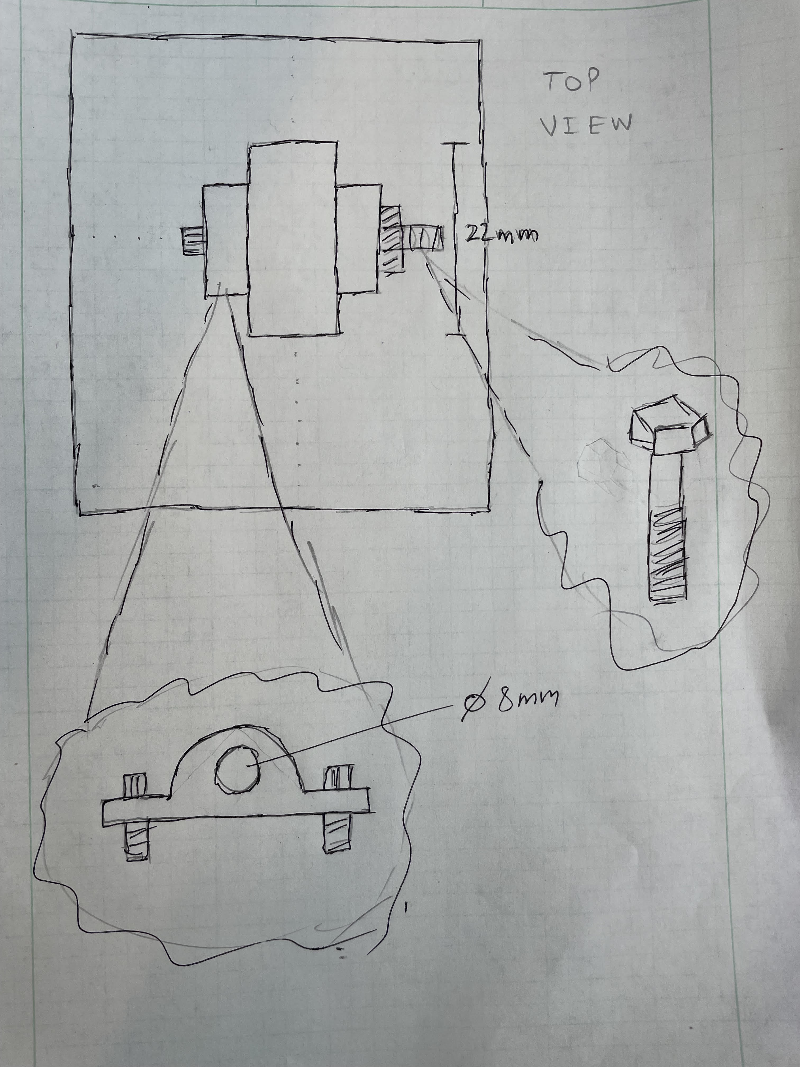
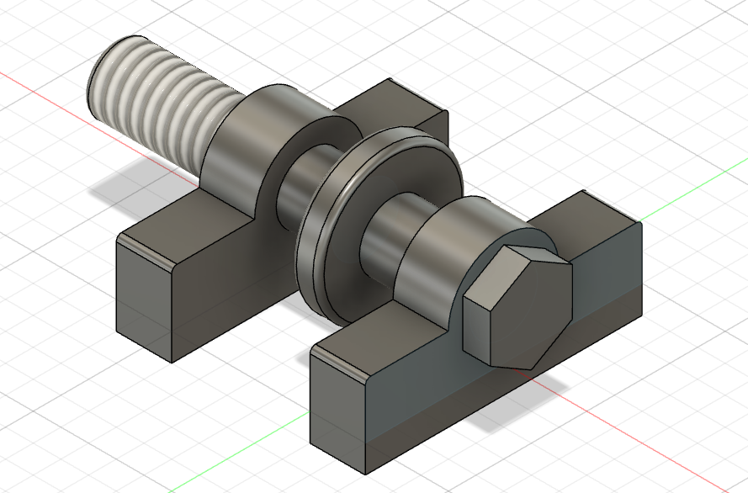



[Vishal] New Inverted Pendulum
Progress completed this past week
-Working on new pin connection between the stand and pendulum
-Using a ball bearing
-Slot fit between Pendulum arm and ball bearing
Included spaces between ball bearing and hinges
-Highlight based on: 60%
Goals for next week
Improved CAD model with Pendulum attached
Proper dimensions
Anticipated challenges
Class conflicts
Completed model
7

Slide 8
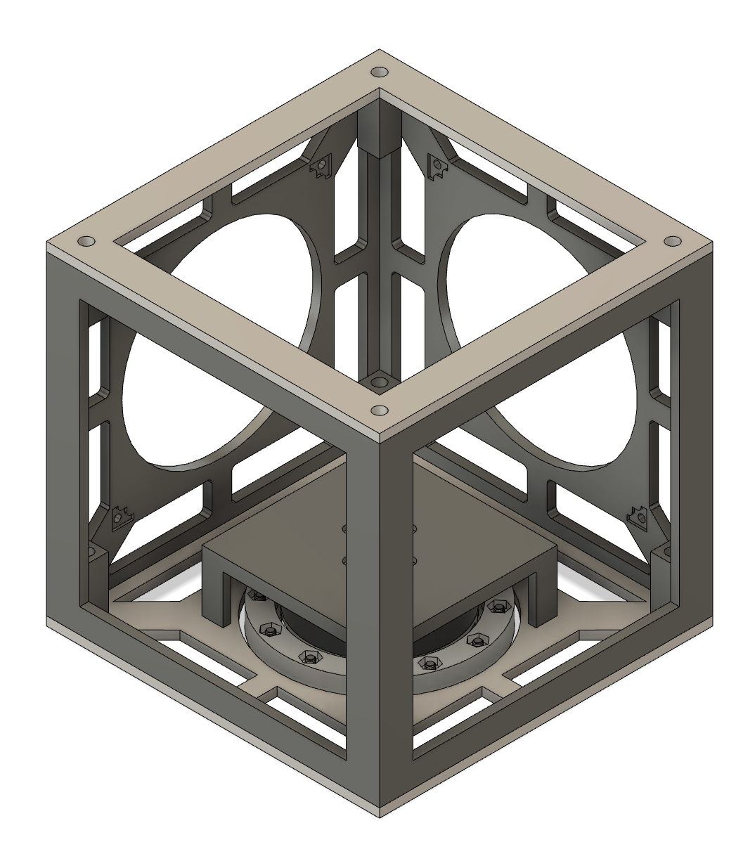
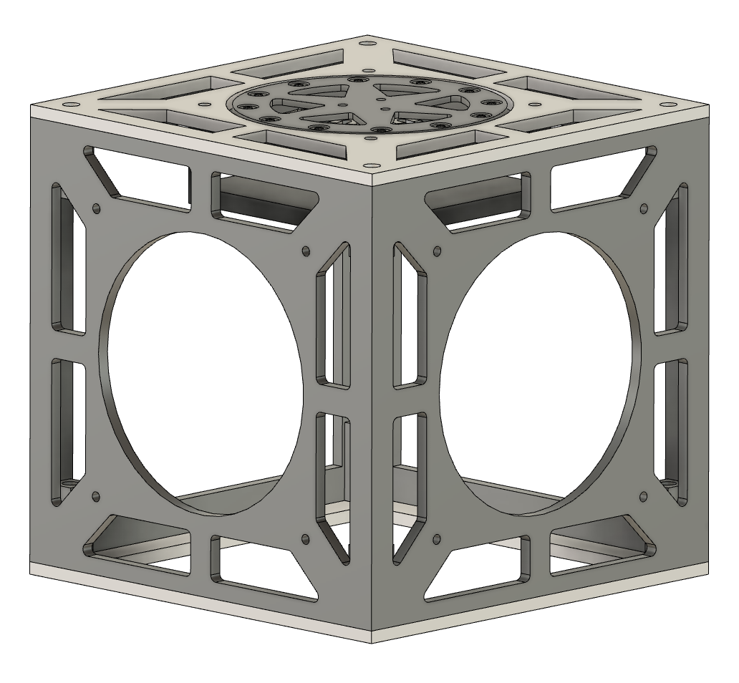
[Isaac] Daisy Chaining O-Drives
Progress completed this past week
-Fixed height of pizza table
-Fixed openings on cubeSat sides for ease of use
-Partially made new pizza table to fit 3 inside
cubesat
Goals for next week
-Finish pizza table
-Fix the mounts for three main cubesat body for new pizza table
Anticipated challenges
-iterations to fit all into the smallest space

Slide 9
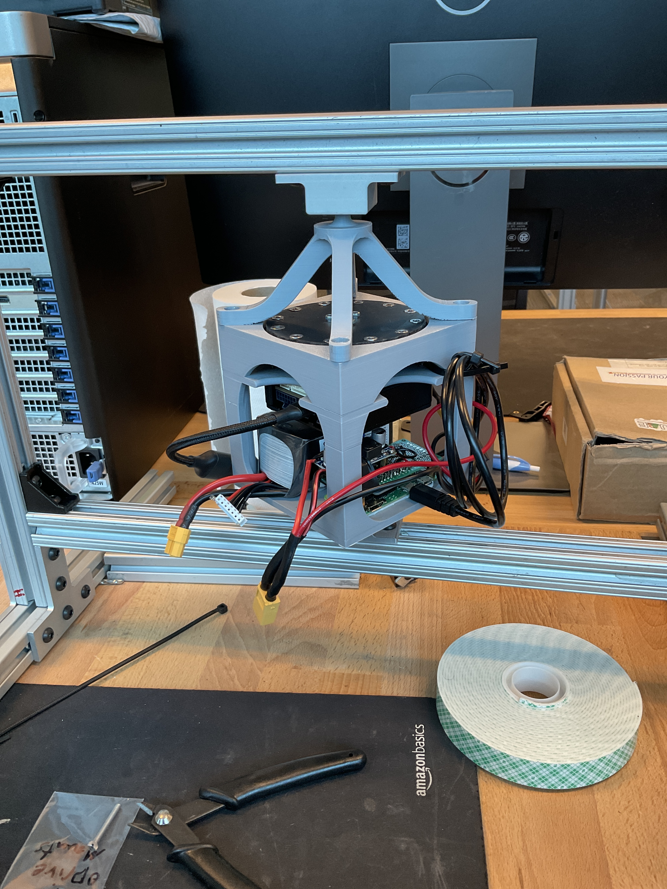
Visual System Updates
Notes:
Duplicate slide and fill in relevant information

Slide 10
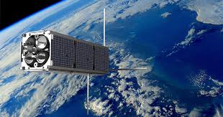
[Assignee] + [Task Title]
Progress completed this past week
-[Discuss progress]
-Highlight based on: Complete, >50%, <50%
Goals for next week
-[Discuss goals]
Anticipated challenges
-[discuss challenges, request assistance if needed]
[Relevant photos if needed]
COPY
Notes:
Duplicate slide and fill in relevant information

